Slide 1
Analysis of:
Unemployment Rates
Vs. Suicides

Slide 2
Big Question:
Is there a correlation between Unemployment and Suicide Rates in America?

Slide 3
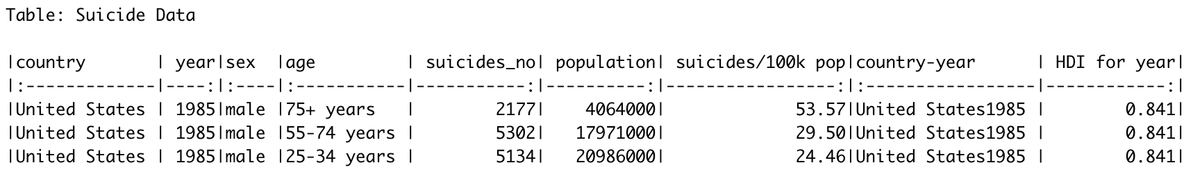
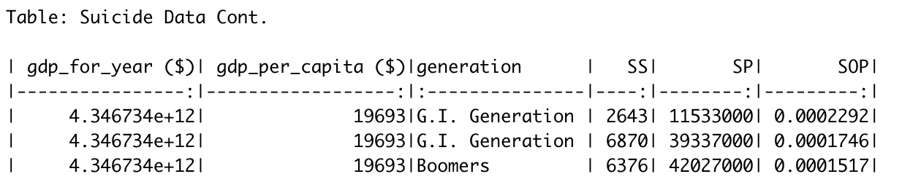
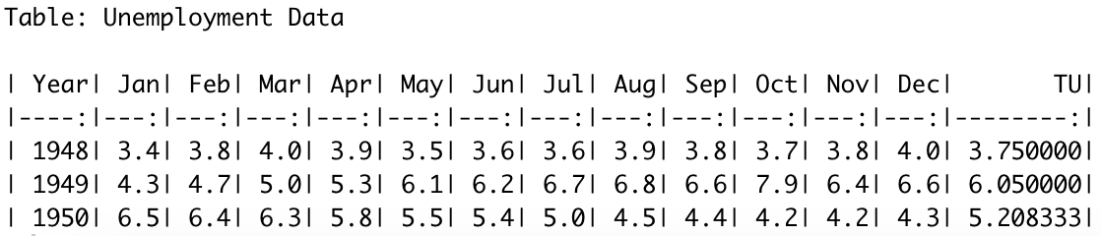

Slide 4
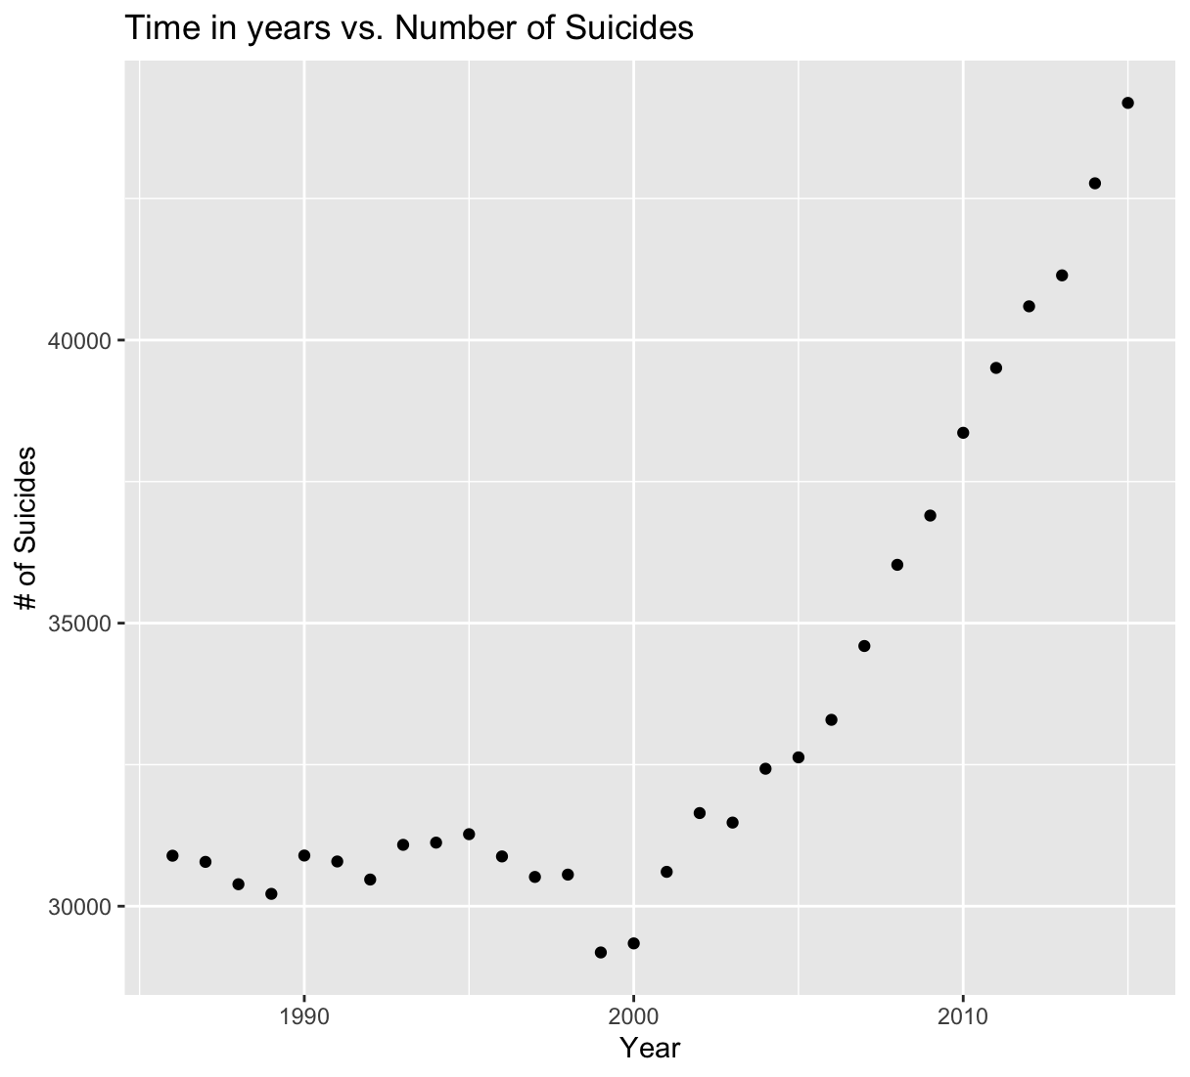

Slide 5
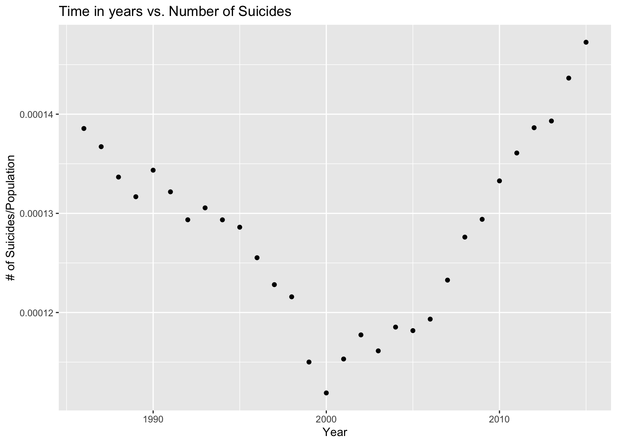

Slide 6
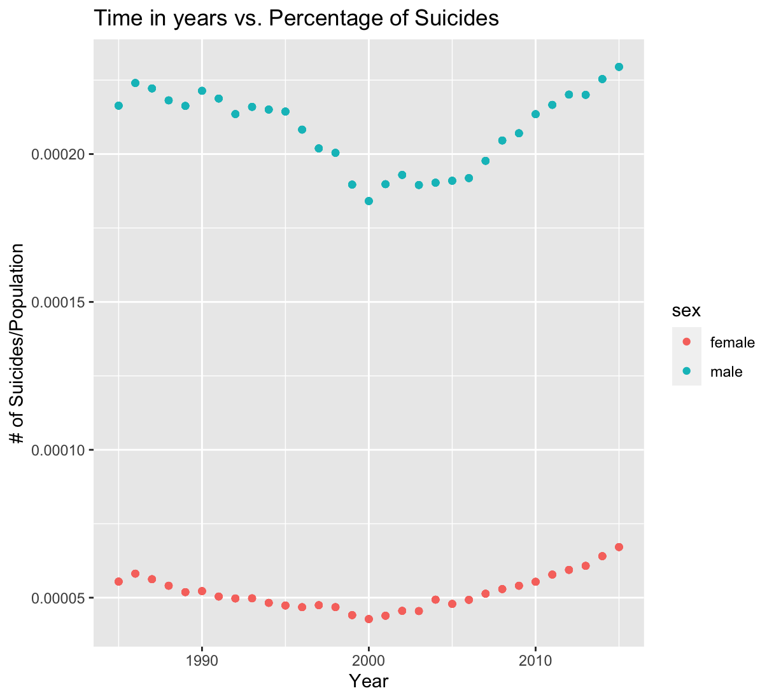
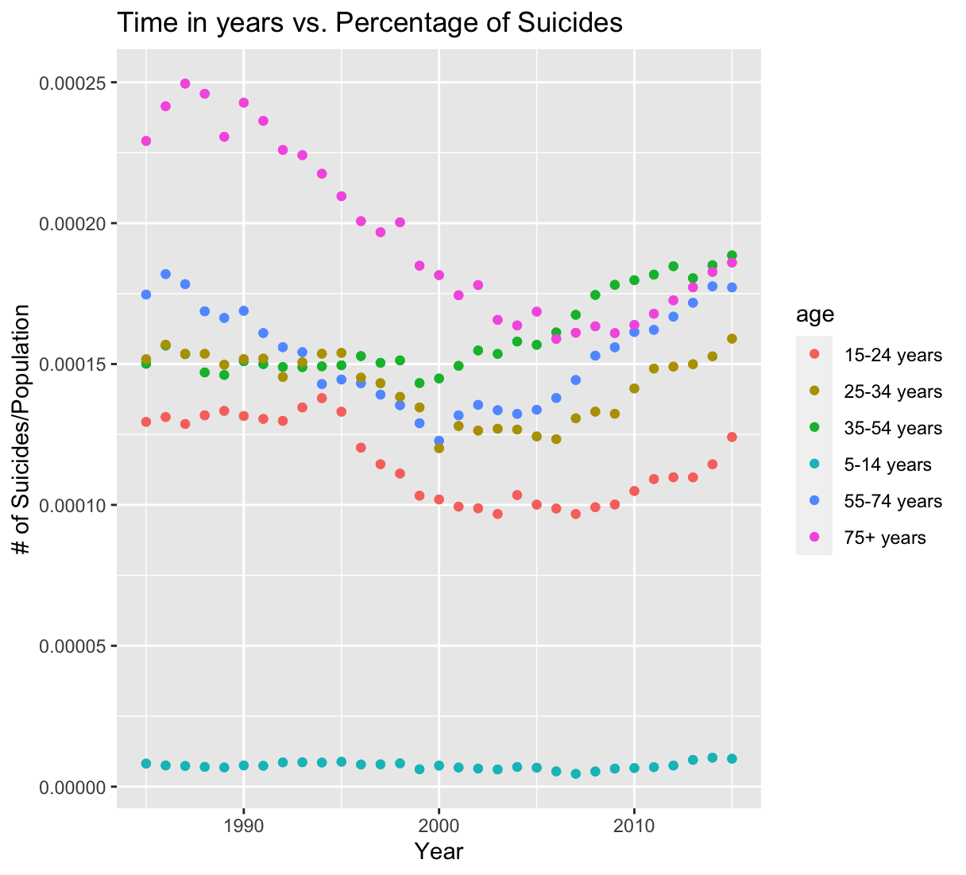

Slide 7
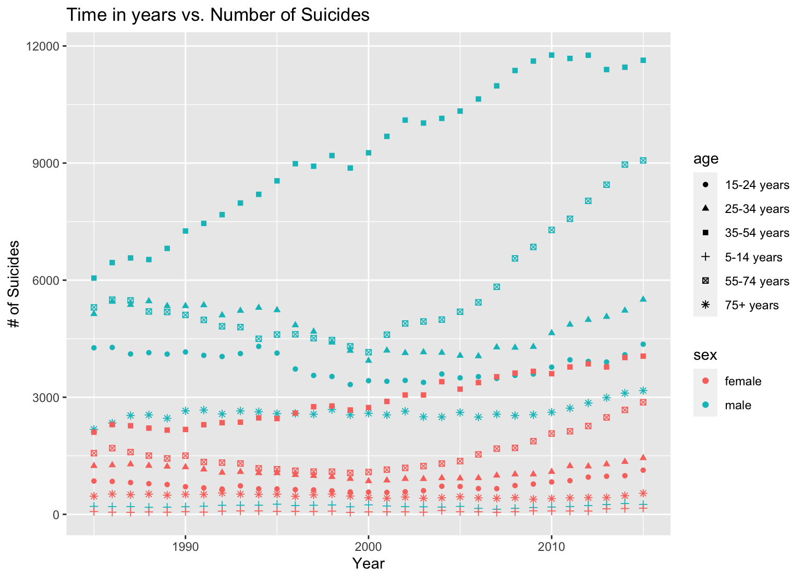
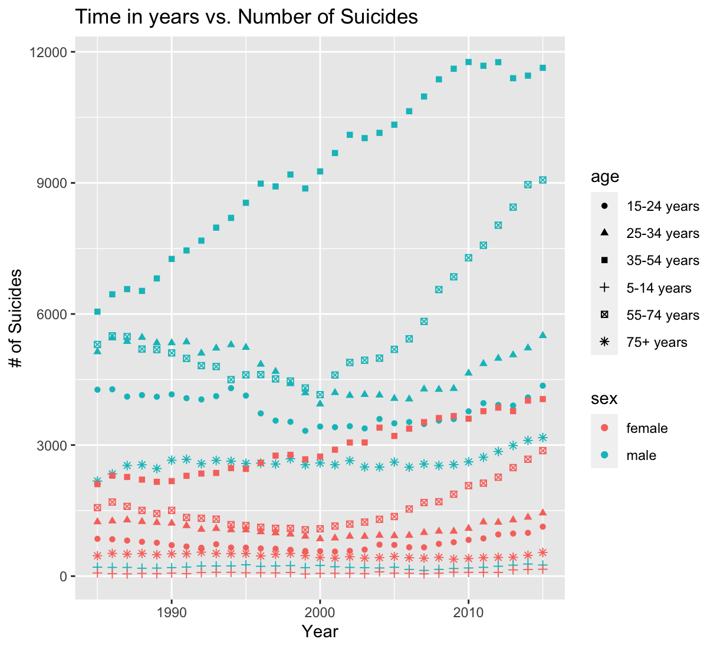

Slide 8
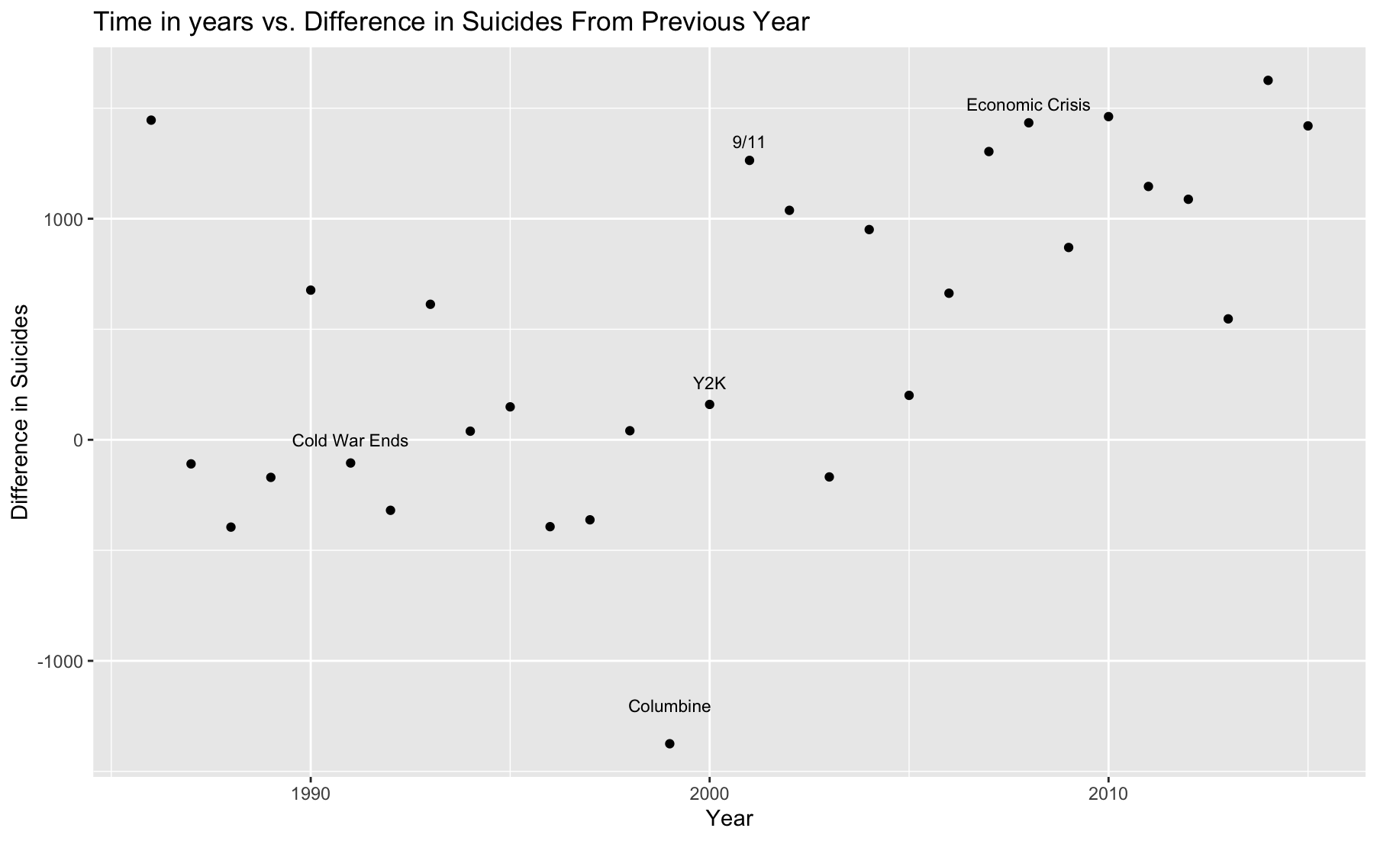

Slide 9
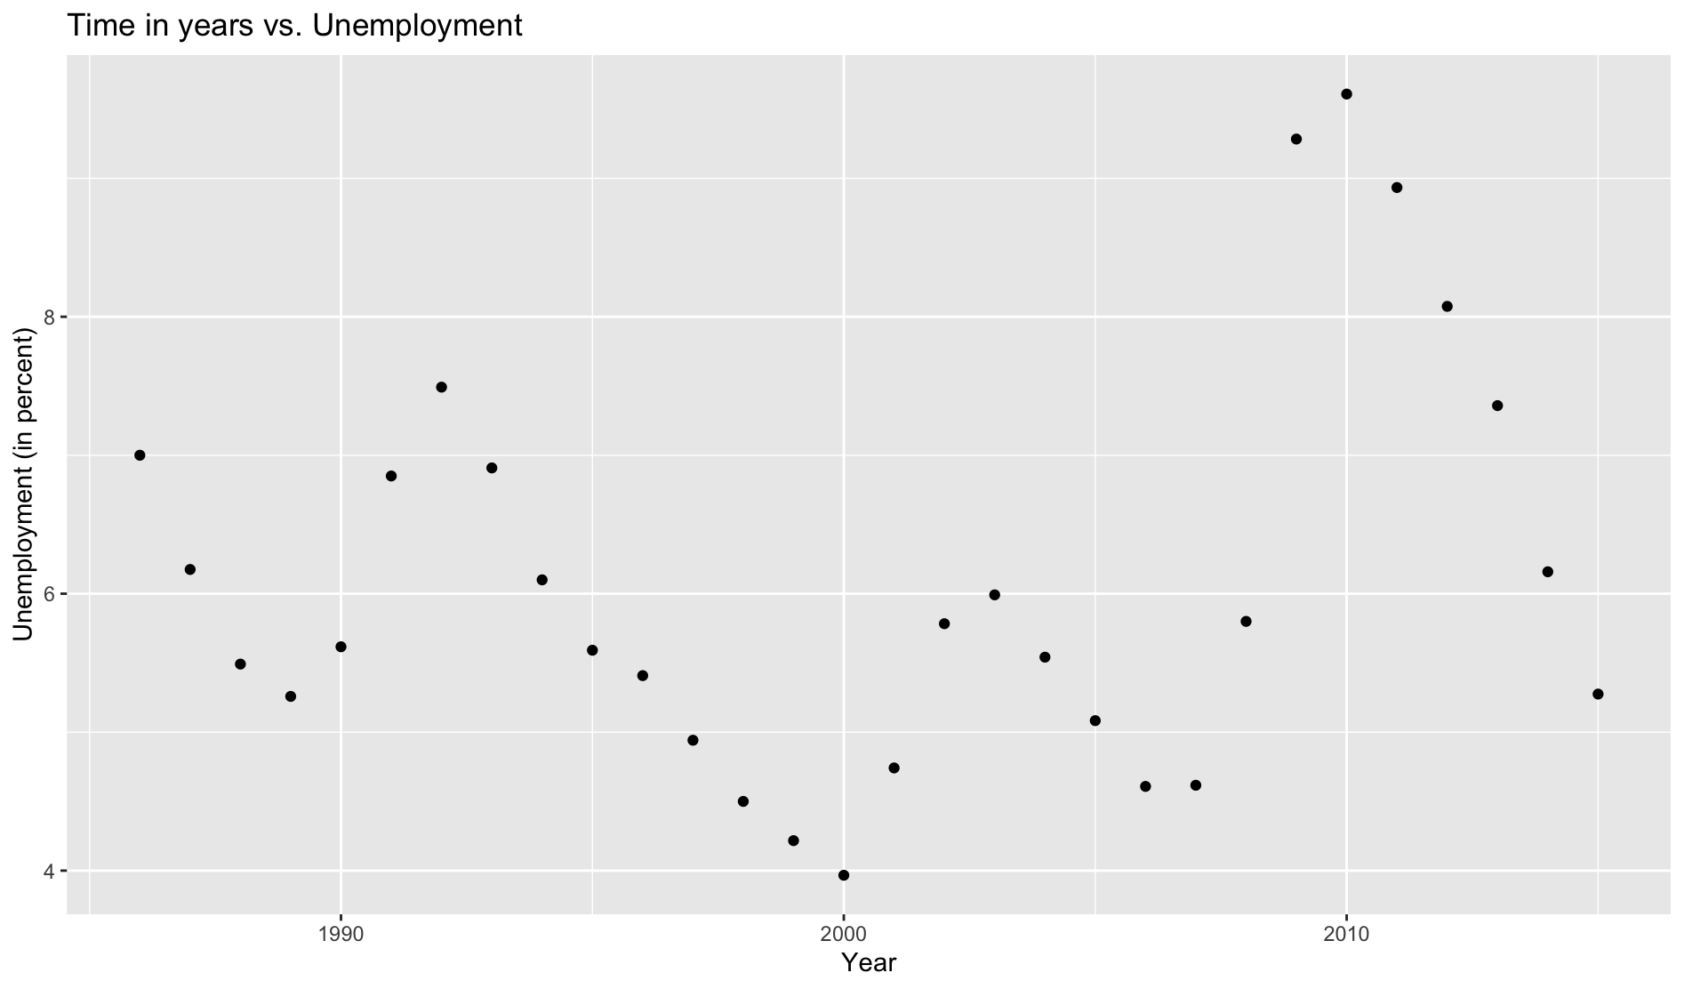

Slide 10
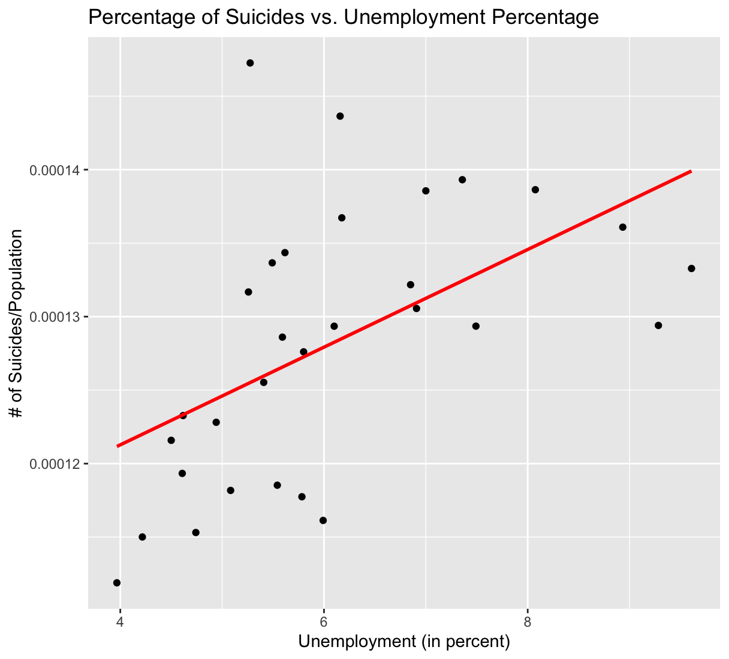
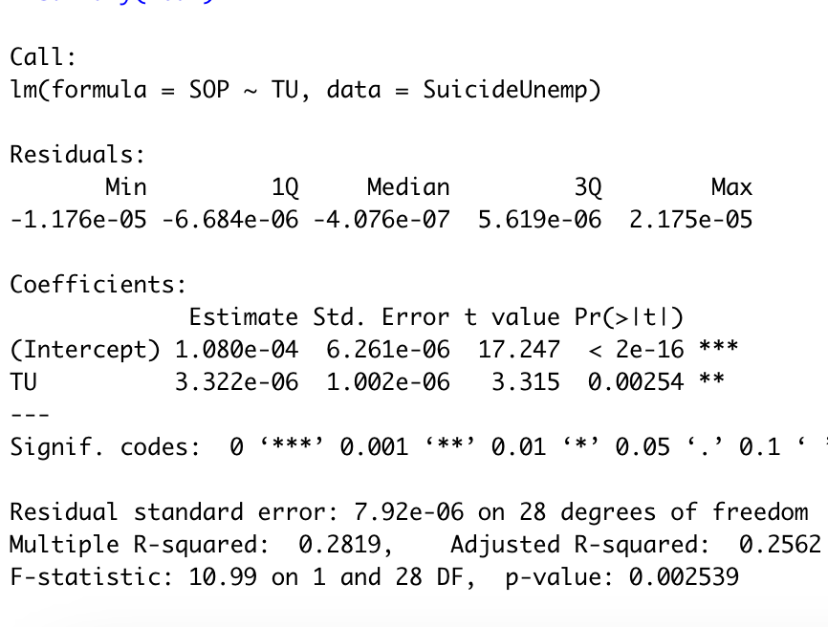

Slide 11
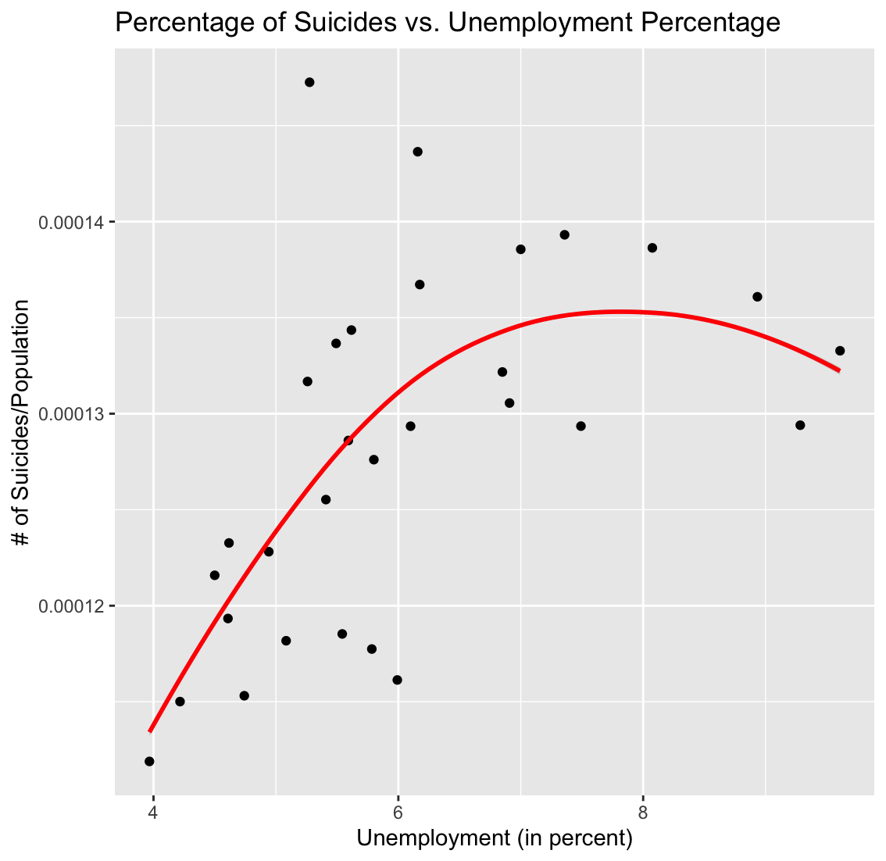
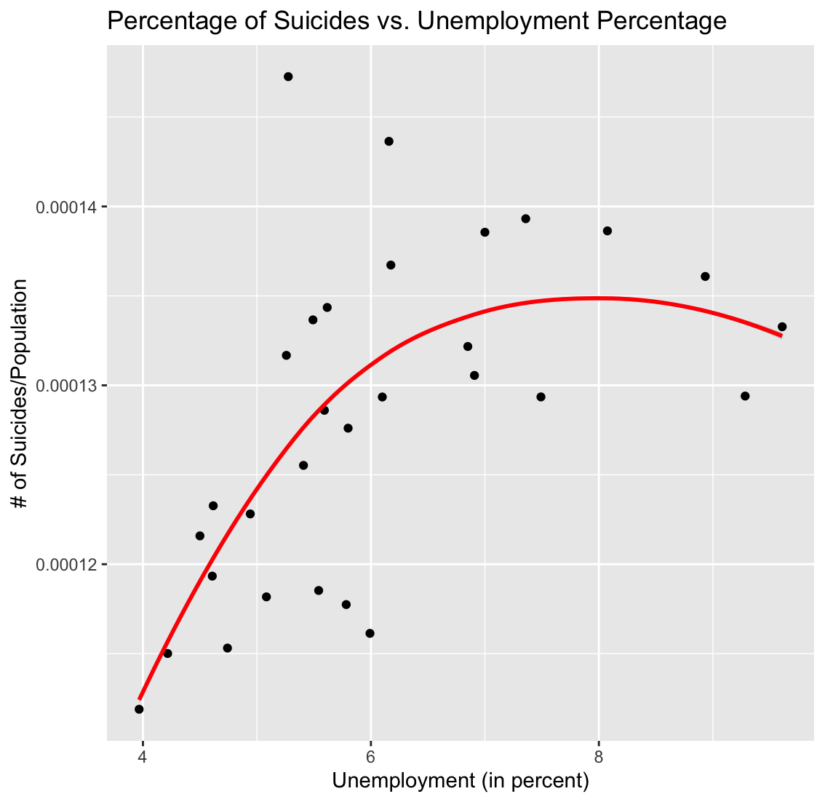

Slide 12
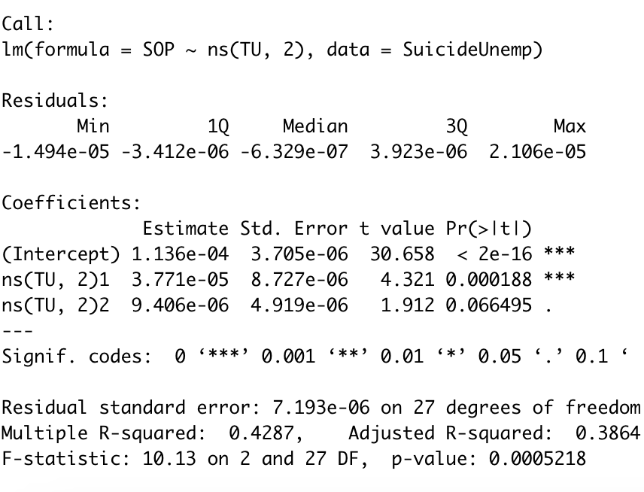
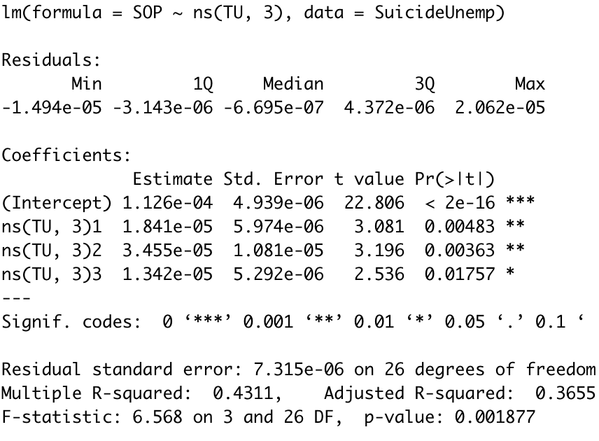

Slide 13
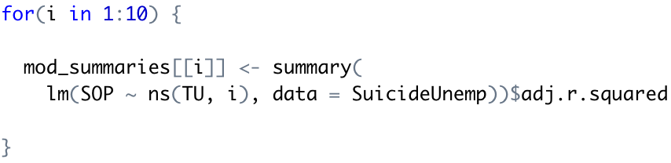
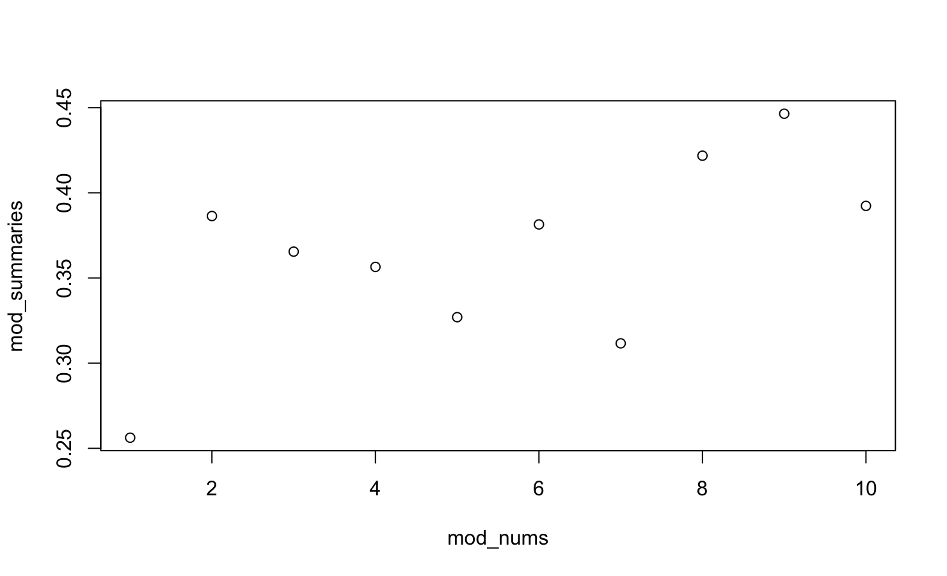

Slide 14
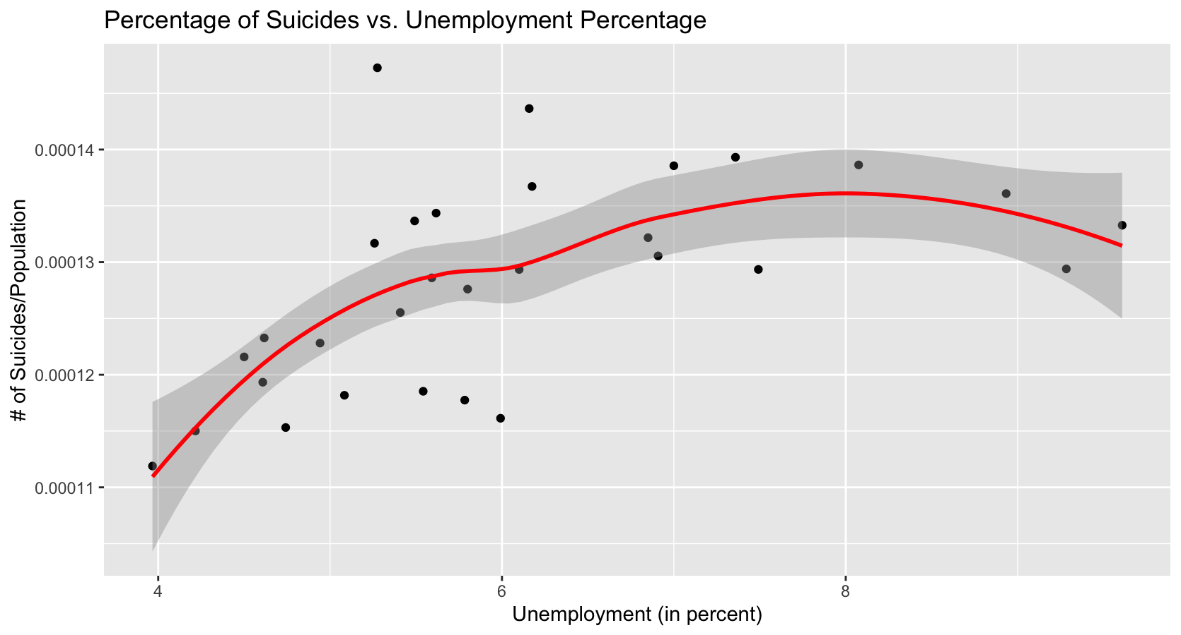
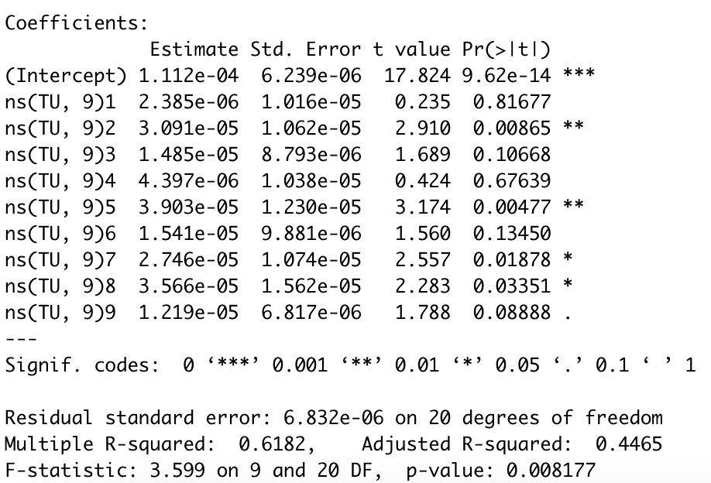

Slide 15
Conclusions
There are large disparities with suicide rates based on gender and age group.
Based on the models suicide rates and unemployment seem to be correlated, best model created between suicide and unemployment includes a natural spline of 9.
If I were to continue analysis into this subject, I would try to find a different dataset that would be suitable for dynamic effects. As well as find an unemployment set that includes identifiers such as gender or age group variables so that further conclusions regarding disparity can be drawn

Slide 16
Data Sets:
Suicide:
https://www.kaggle.com/russellyates88/suicide-rates-overview-1985-to-2016
Unemployment:
https://www.kaggle.com/tunguz/us-monthly-unemployment-rate-1948-present

